Slide 1

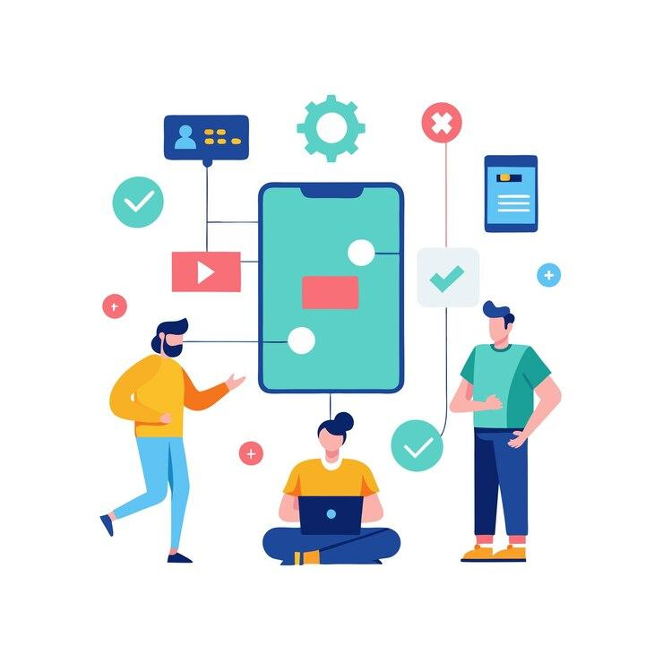
How Modern Applications Work
Understanding Modern Web Application Architecture
1

Slide 2
Session Agenda
01
02
Concept Introduction
Frontend vs Backend
Client vs Server, Web Apps
UI and server-side logic
03
04
Deployment & DevOps
Real-World Example
Going live and automation culture
Food delivery app workflow
05
06
Downtime & Team Roles
HTTP Basics & Scenarios
Impact and responsibilities
Protocols, methods, and discussion
2

Slide 3
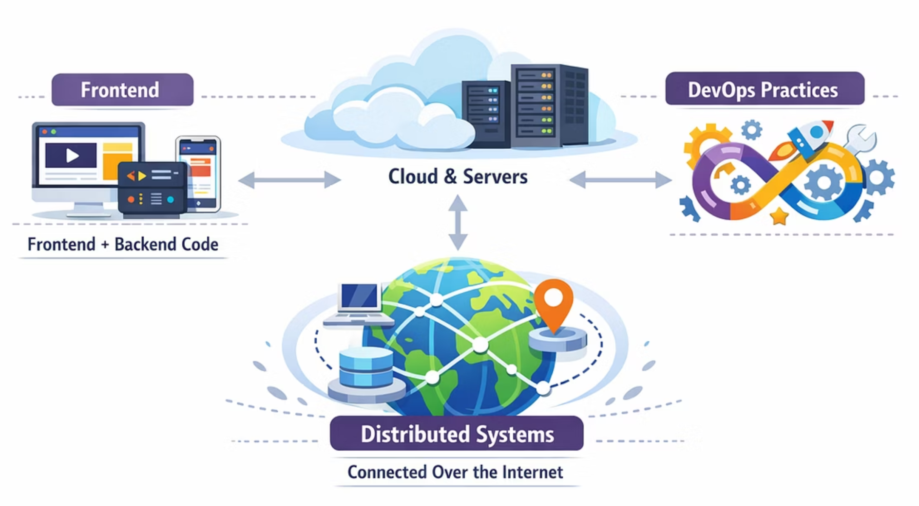
CONCEPT INTRODUCTION
How Modern Applications Work
Modern applications are distributed systems connected over the internet, built using frontend + backend, hosted on cloud or servers, and managed by DevOps practices.
Instagram
Amazon
Swiggy
Netflix
3

Slide 4
Client vs Server
🖥️ Client
🗄️ Server
User's device (Laptop, Mobile)
Uses browser or app
Sends request
Powerful computer
Processes request
Sends response
4

Slide 5
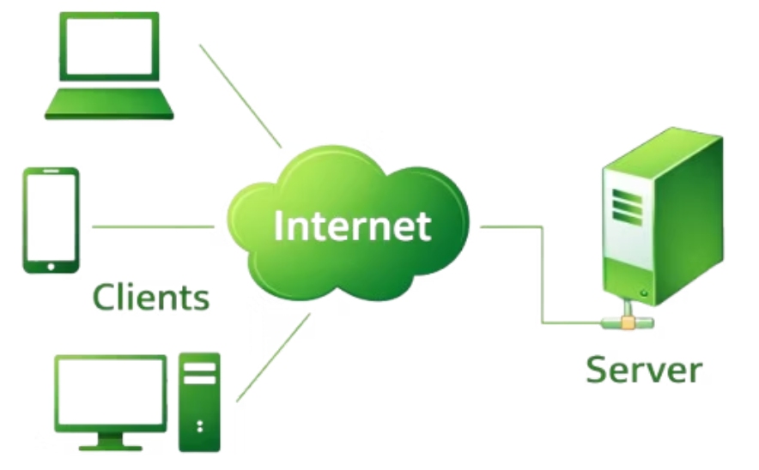



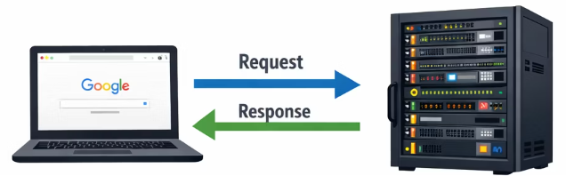
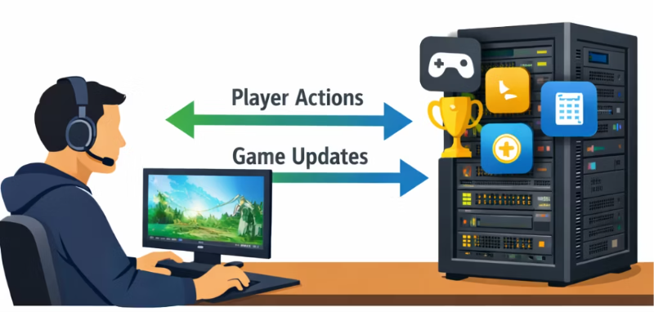
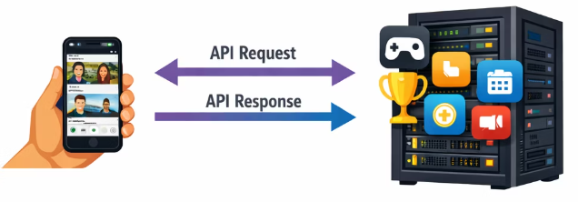
Real-Life Client-Server Examples
The client-server architecture is fundamental to almost every digital interaction we have daily, from browsing the web to playing online games.
Web Browsers and Web Servers
Mobile Apps and Backend APIs
Gaming Platforms
Browsers like Chrome and Safari act as clients, sending requests to web servers to load pages.
Apps like Instagram and Amazon communicate with servers to fetch user data, posts, or product listings.
Online games use client-server models to synchronize player actions, game state, and scores with central servers.
5

Slide 6
Quiz Time
Q1. When you open a website on your phone, who is the client – your phone or the server?
✅ Answer: Your phone (or browser) is the client because it sends the request.
Q2. What happens after you click a button on a website?
✅ Answer: The browser sends a request to the server, and the server processes it and sends a response back.
Q3. Why do websites need a server instead of working only on your phone?
✅ Answer: Servers store data and process requests. Your phone alone cannot store and manage all the website data.
6

Slide 7
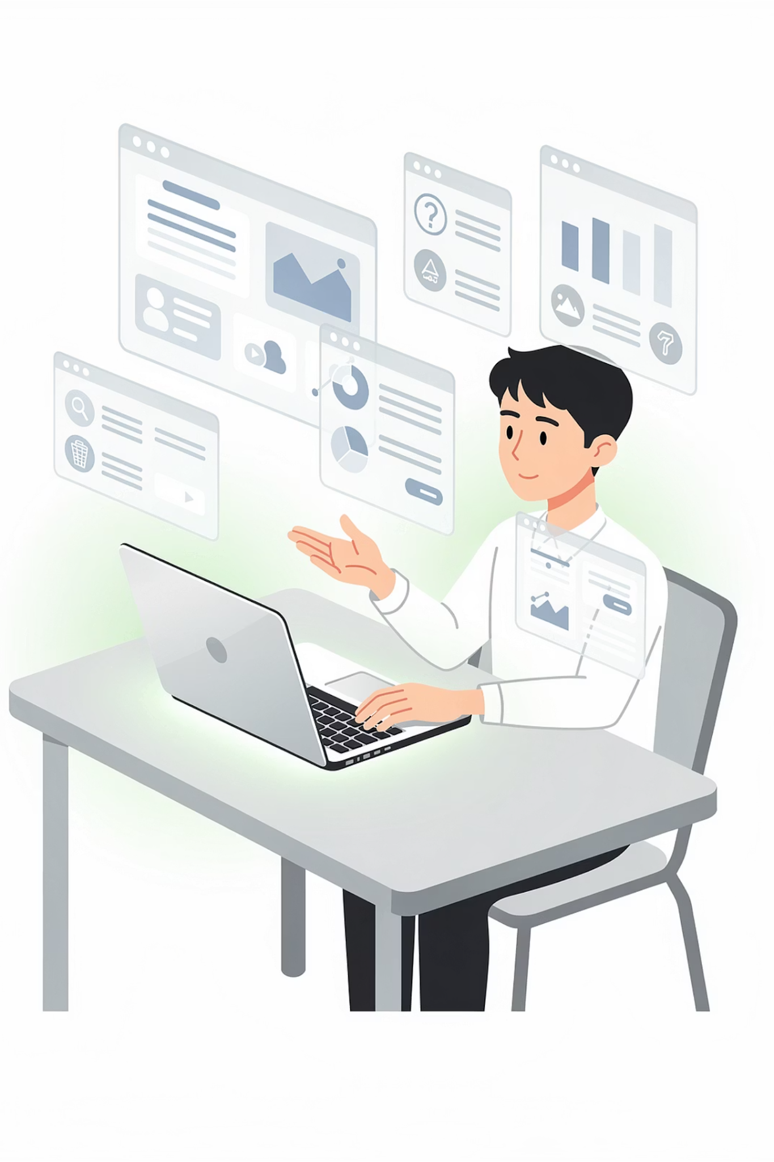

WEB APPLICATIONS
What is a Web Application?
A Web Application is software running on a server, accessed via a web browser, and requires internet. Examples include Gmail, Facebook, and Amazon.
Key Difference: Website = mostly static content. Web App = interactive + dynamic.
7

Slide 8
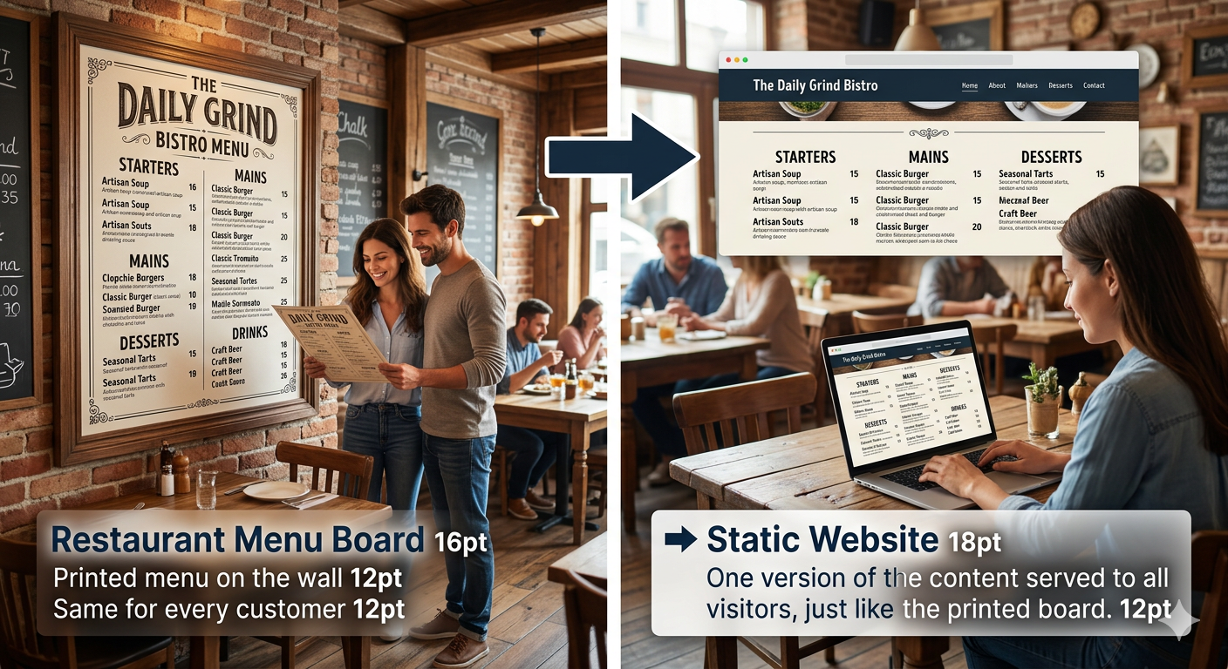
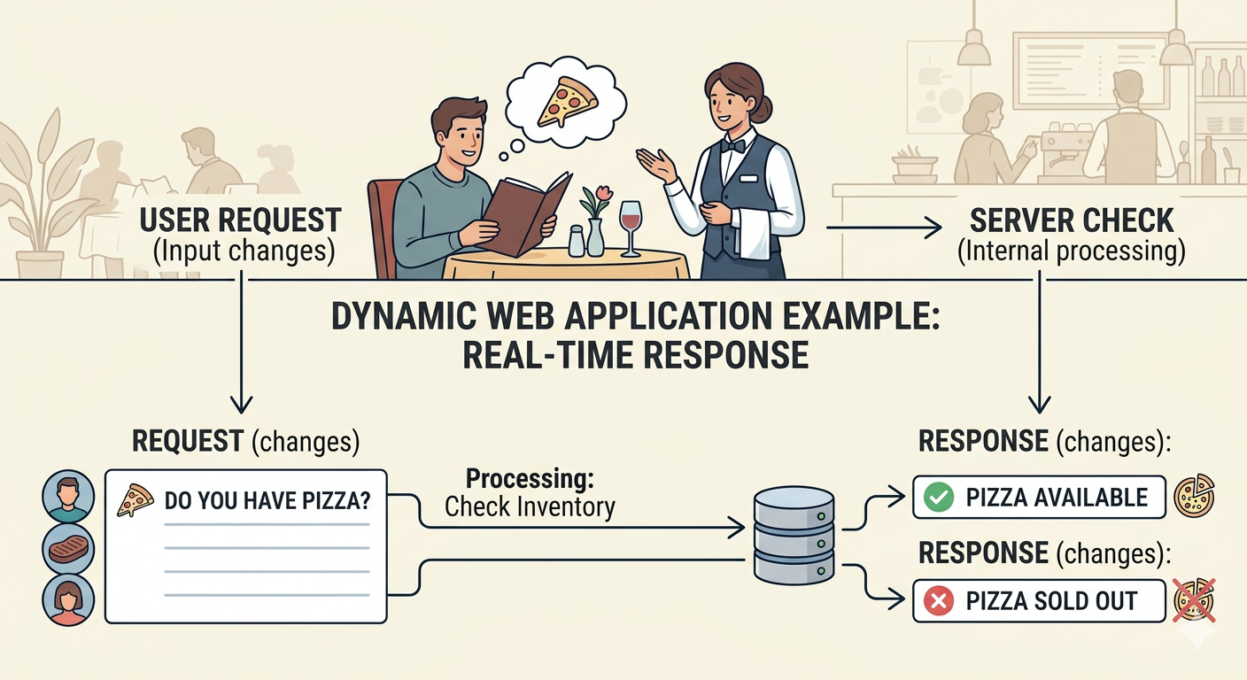
Static vs Dynamic
Static Website
Dynamic Web Application
Fixed content
Same for all users
Example: Portfolio website (Restaurant Menu Board)
Content changes per user
User login required
Database connected
Example: Waiter Taking Orders
8

Slide 9
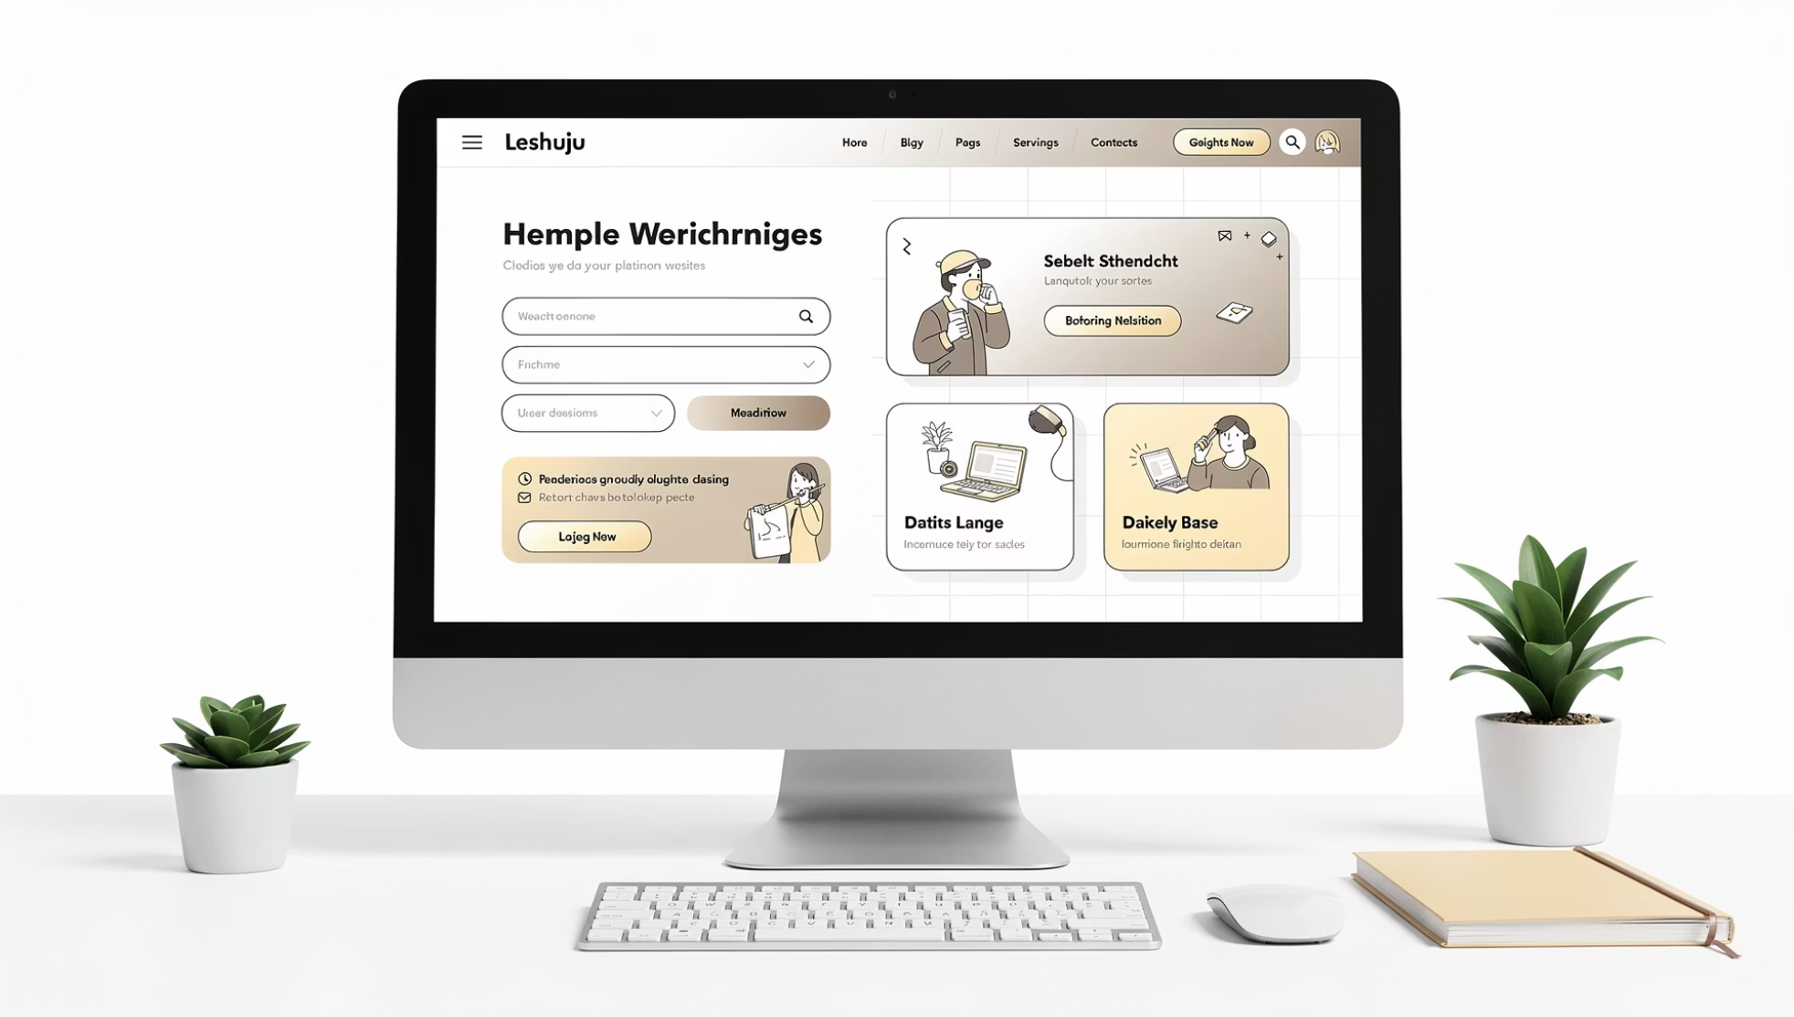




FRONTEND
Frontend (Client Side)
Frontend is what users see — the UI including buttons, forms, and images.
Technologies
Example: Login page design
HTML
CSS
JavaScript
React / Angular / Vue
9

Slide 10
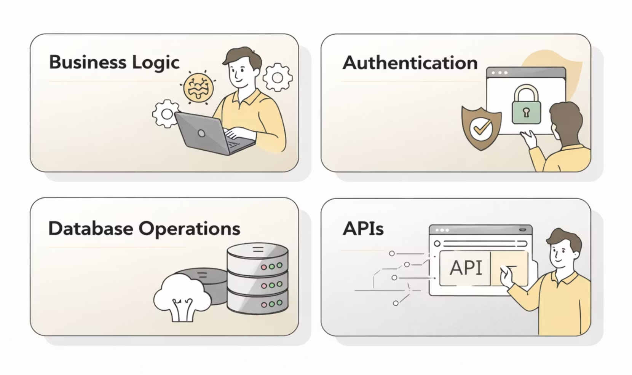

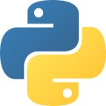


BACKEND
Backend (Server Side)
Backend handles business logic, authentication, database operations, and APIs.
Technologies
Example: Login page design
Node.js
Python
Java
.NET
10

Slide 11
Quiz Time
Q1. When you open an app like Amazon, what parts do you see on the screen?
✅ Answer: Product images, search bar, buttons, and menus. These are part of the frontend.
Q2. Where does the actual processing happen – on your screen or on a server?
✅ Answer: The processing happens on the backend (server).
Q3. Why can users not see the backend of an application?
✅ Answer: Because the backend runs on servers and handles data, logic, and security.
11

Slide 12
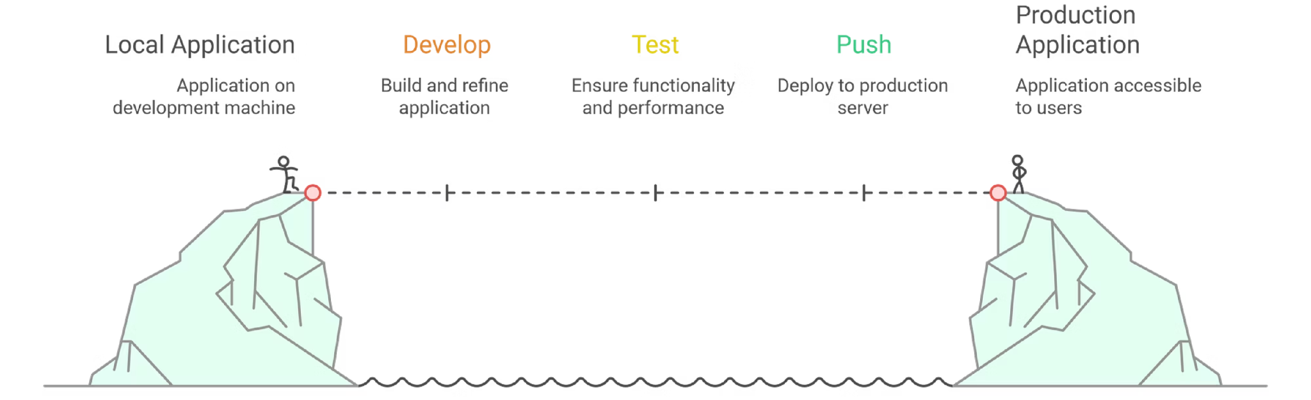
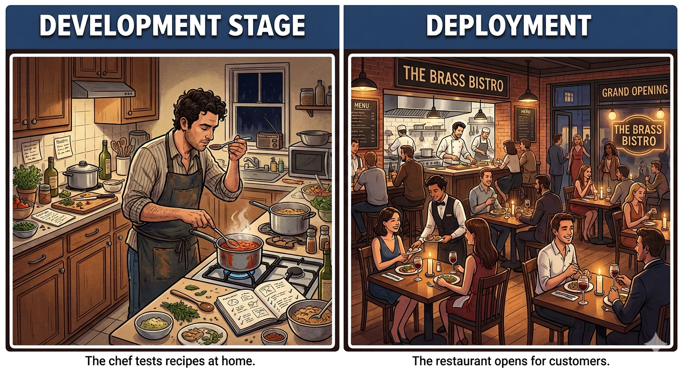
DEPLOYMENT
What is Deployment?
Deployment means moving your application from Local Machine → Production Server.
This process takes code from a developer's laptop to a live server where real users can access it.
Example: Opening a Restaurant Branch
12

Slide 13


Local vs Production
Local
Production
Developer's laptop, testing phase
Live server, real users
localhost:3000
www.myapp.com
13

Slide 14
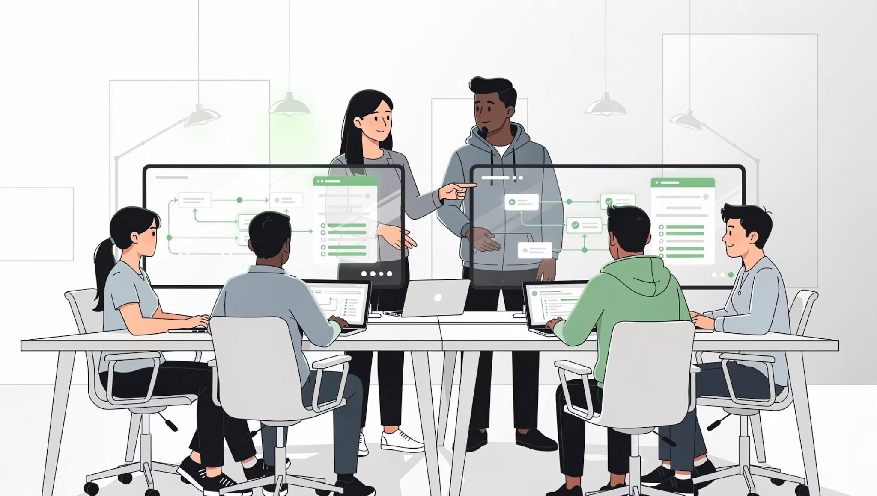
DEVOPS CULTURE
What is DevOps?
DevOps = Development + Operations
Goal: Deliver software faster & reliably.
Automation
Continuous Integration
Continuous Deployment
Monitoring
14

Slide 15
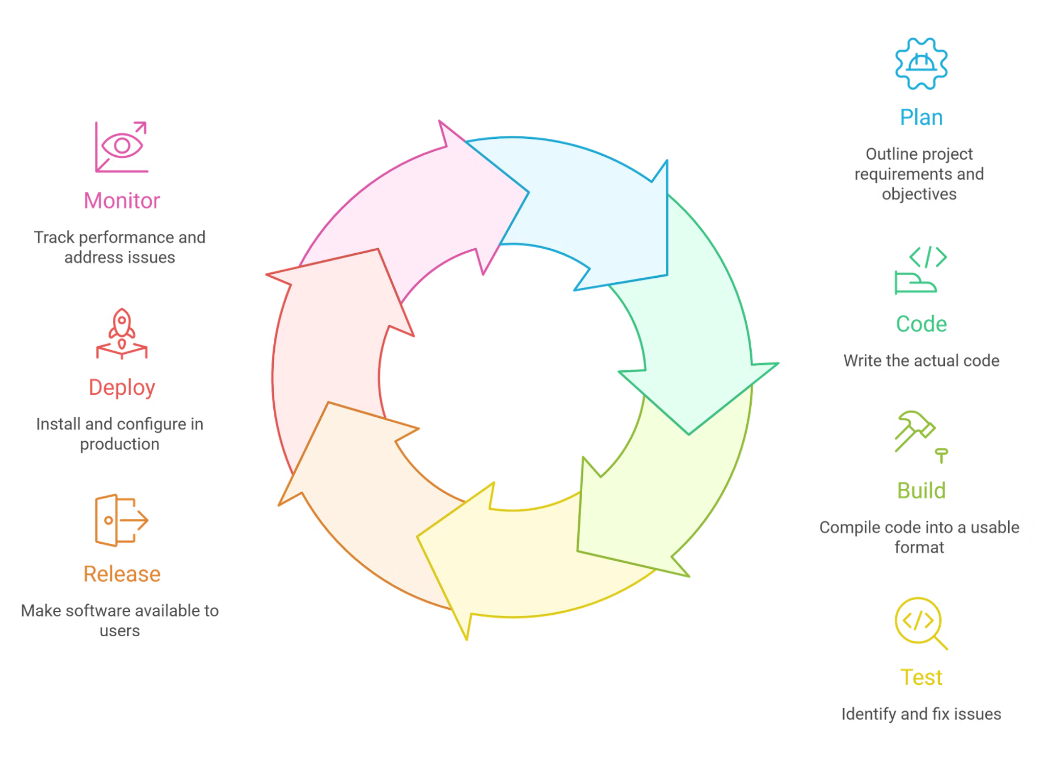
DevOps Lifecycle
15

Slide 16
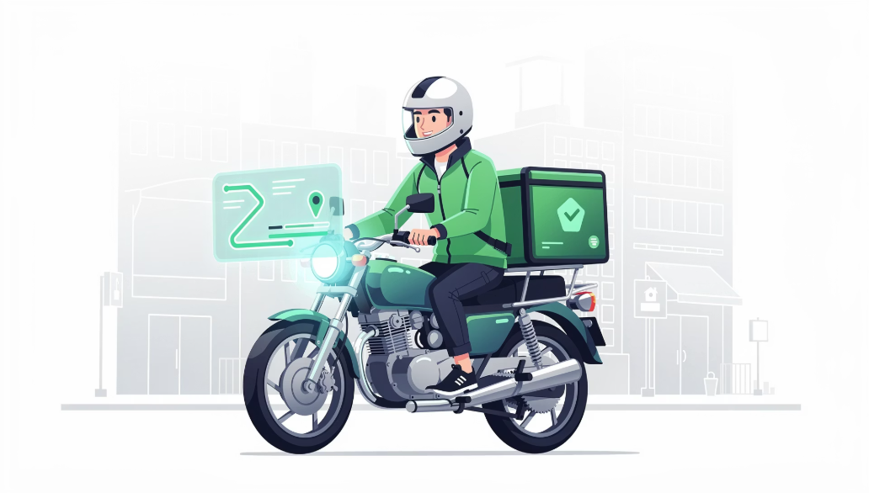
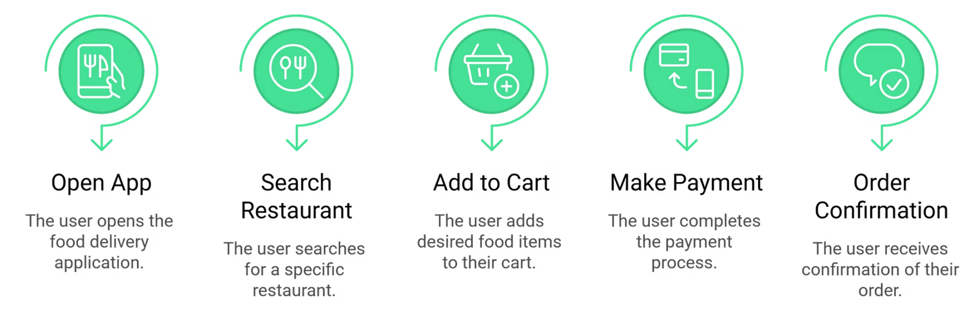
Food Delivery App Workflow
Example: Swiggy / Zomato
16

Slide 17
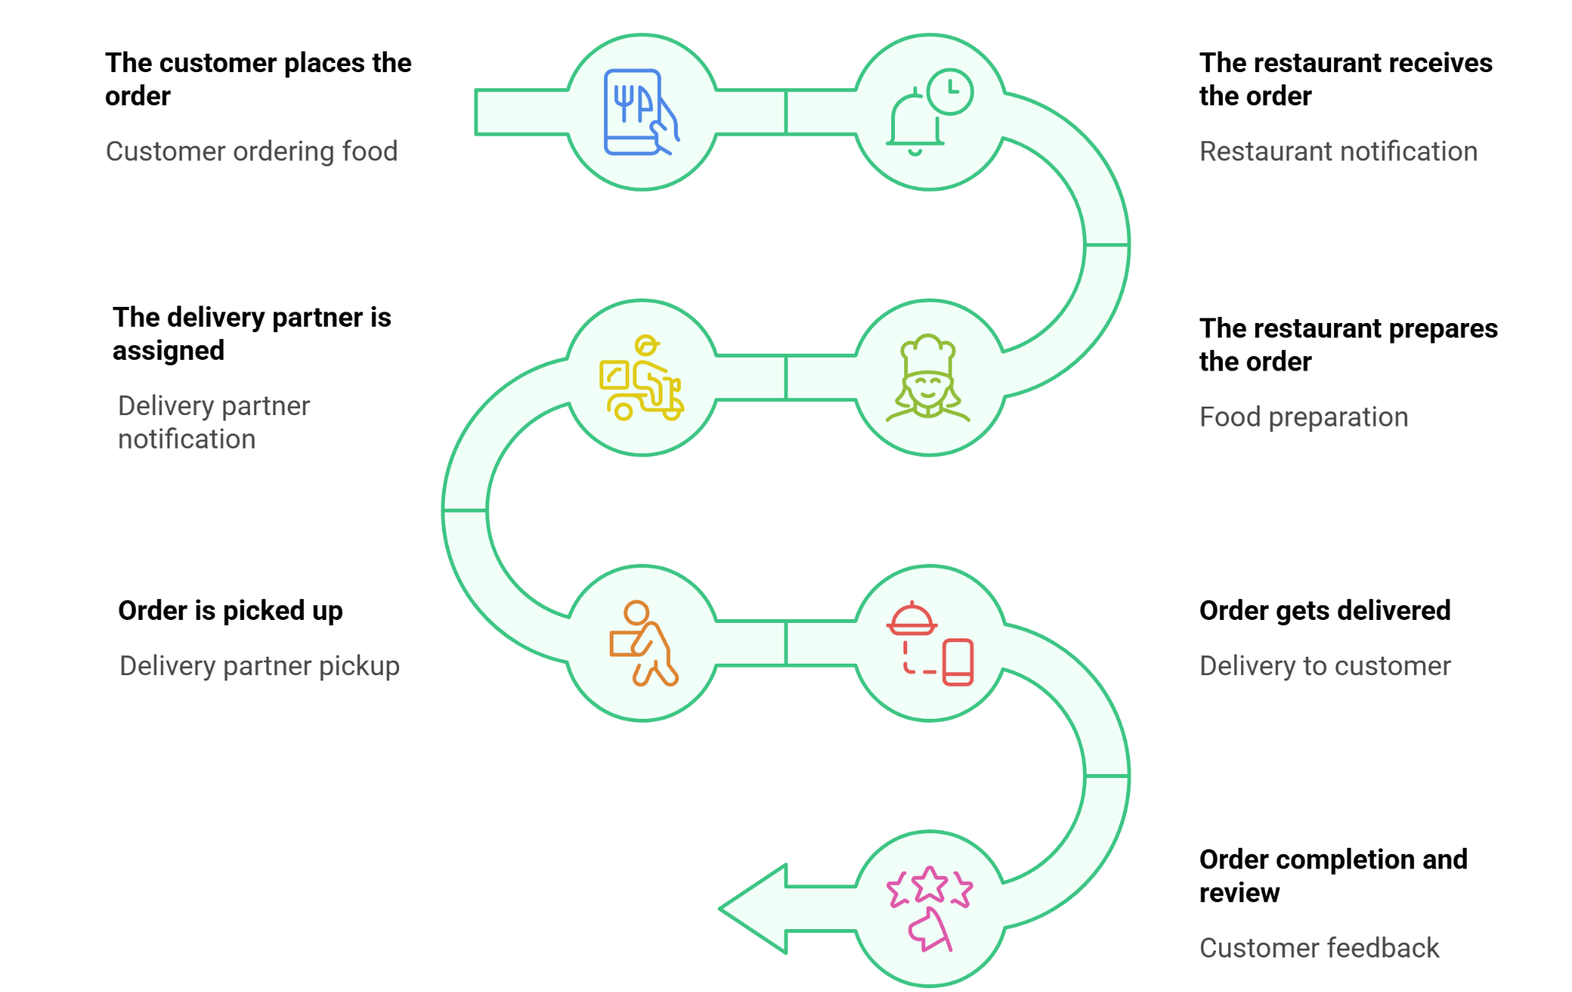
What Happens Behind the Scenes?
Frontend sends request
Backend validates order
Database stores order
Payment gateway
Confirmation sent
17

Slide 18


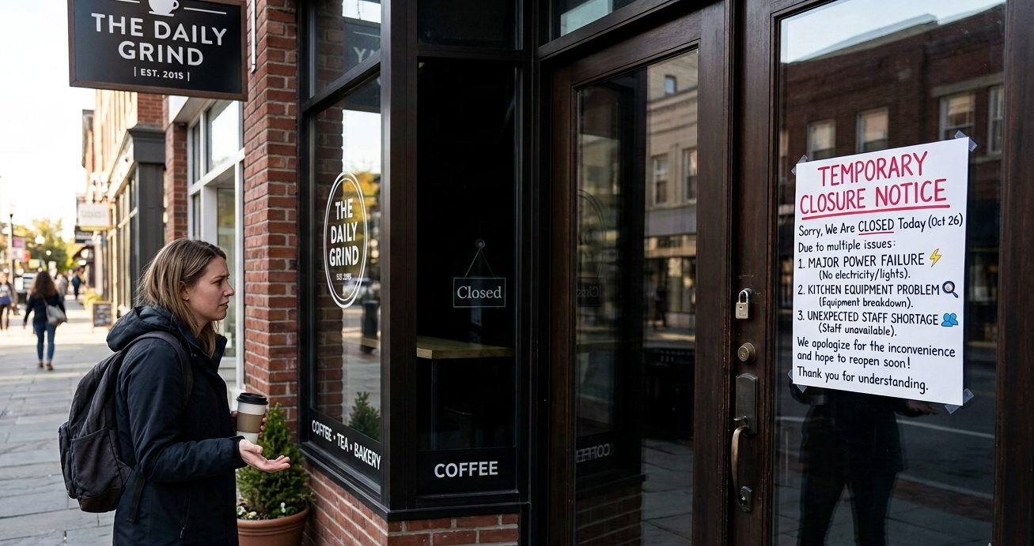



APP DOWNTIME
What is Downtime?
Downtime = When the application is not accessible.
Example: Coffee Shop Closed 🚫
Server Crash
Database Failure
Network Issue
Code Bug
18

Slide 19
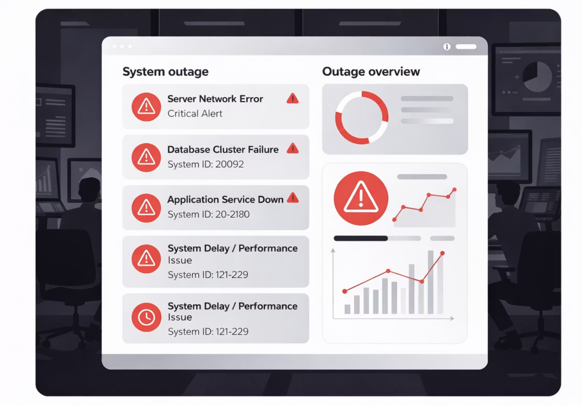

Impact of Downtime
Users cannot login
Payments fail
Company loses money
Brand reputation damage
Example: Amazon down for 1 hour = millions lost.
19

Slide 20
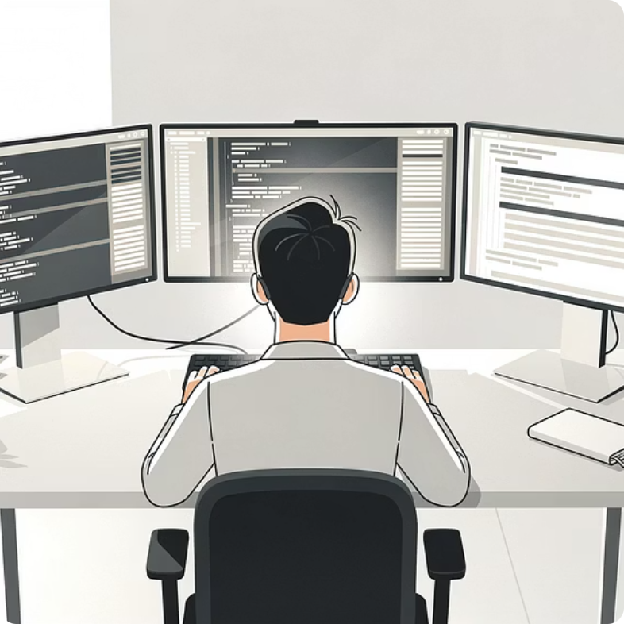
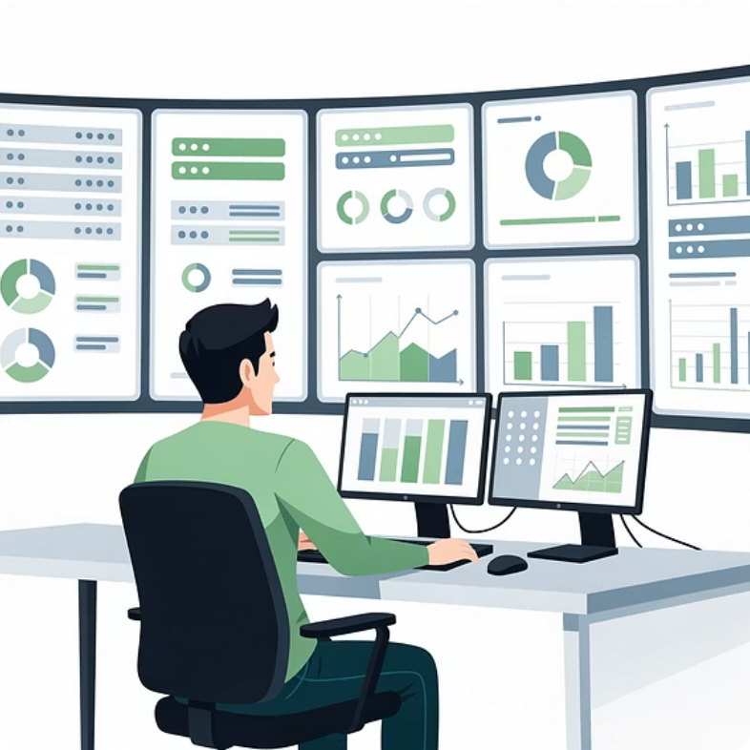
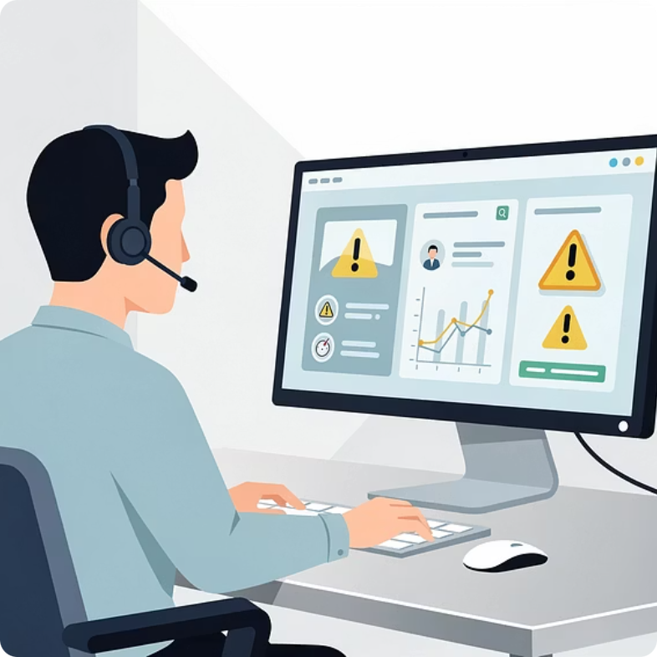
TECH TEAM ROLES
Key Team Roles
Developer (Dev)
Operations (Ops)
Security Team
Write code, build features, fix bugs, push updates
Manage servers, deploy apps, monitor uptime, handle scaling
Prevent hacking, data encryption, security audits, access control
20

Slide 21
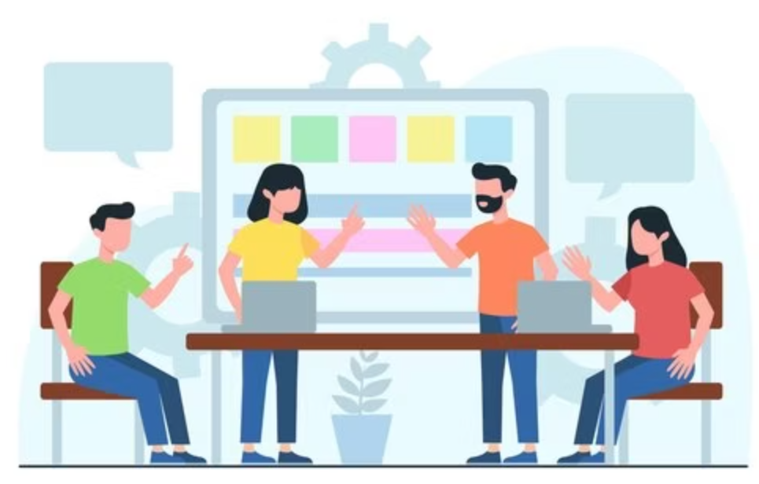
Team Collaboration
Modern teams work together under the DevOps culture — shared ownership, shared responsibility.
1
Dev Builds
2
Ops Deploys
3
Security Secures
21

Slide 22
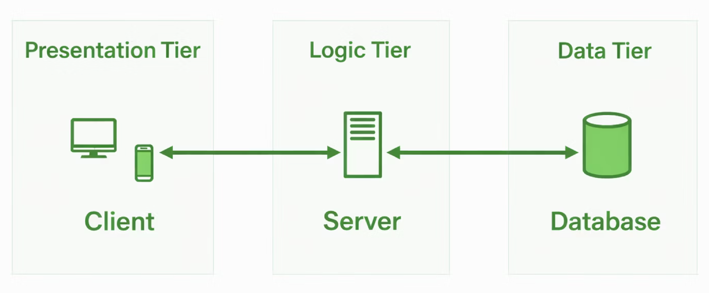
Simple Website Architecture
User → Browser → Internet → Server → Database
22

Slide 23
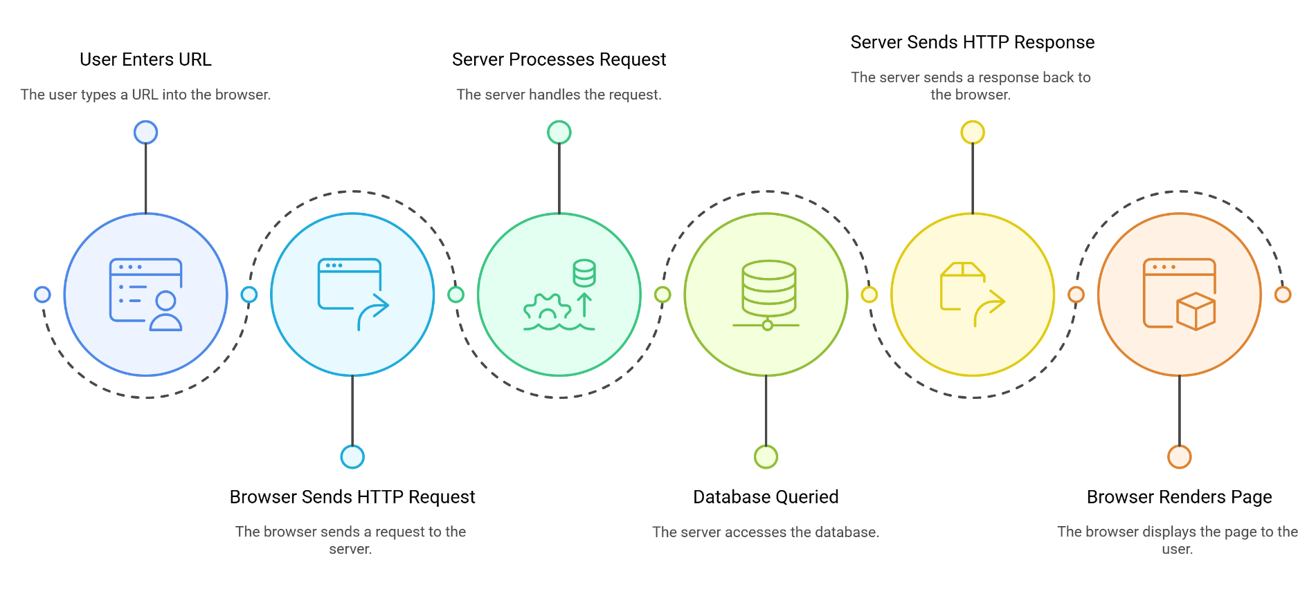
Request / Response Flow
23

Slide 24
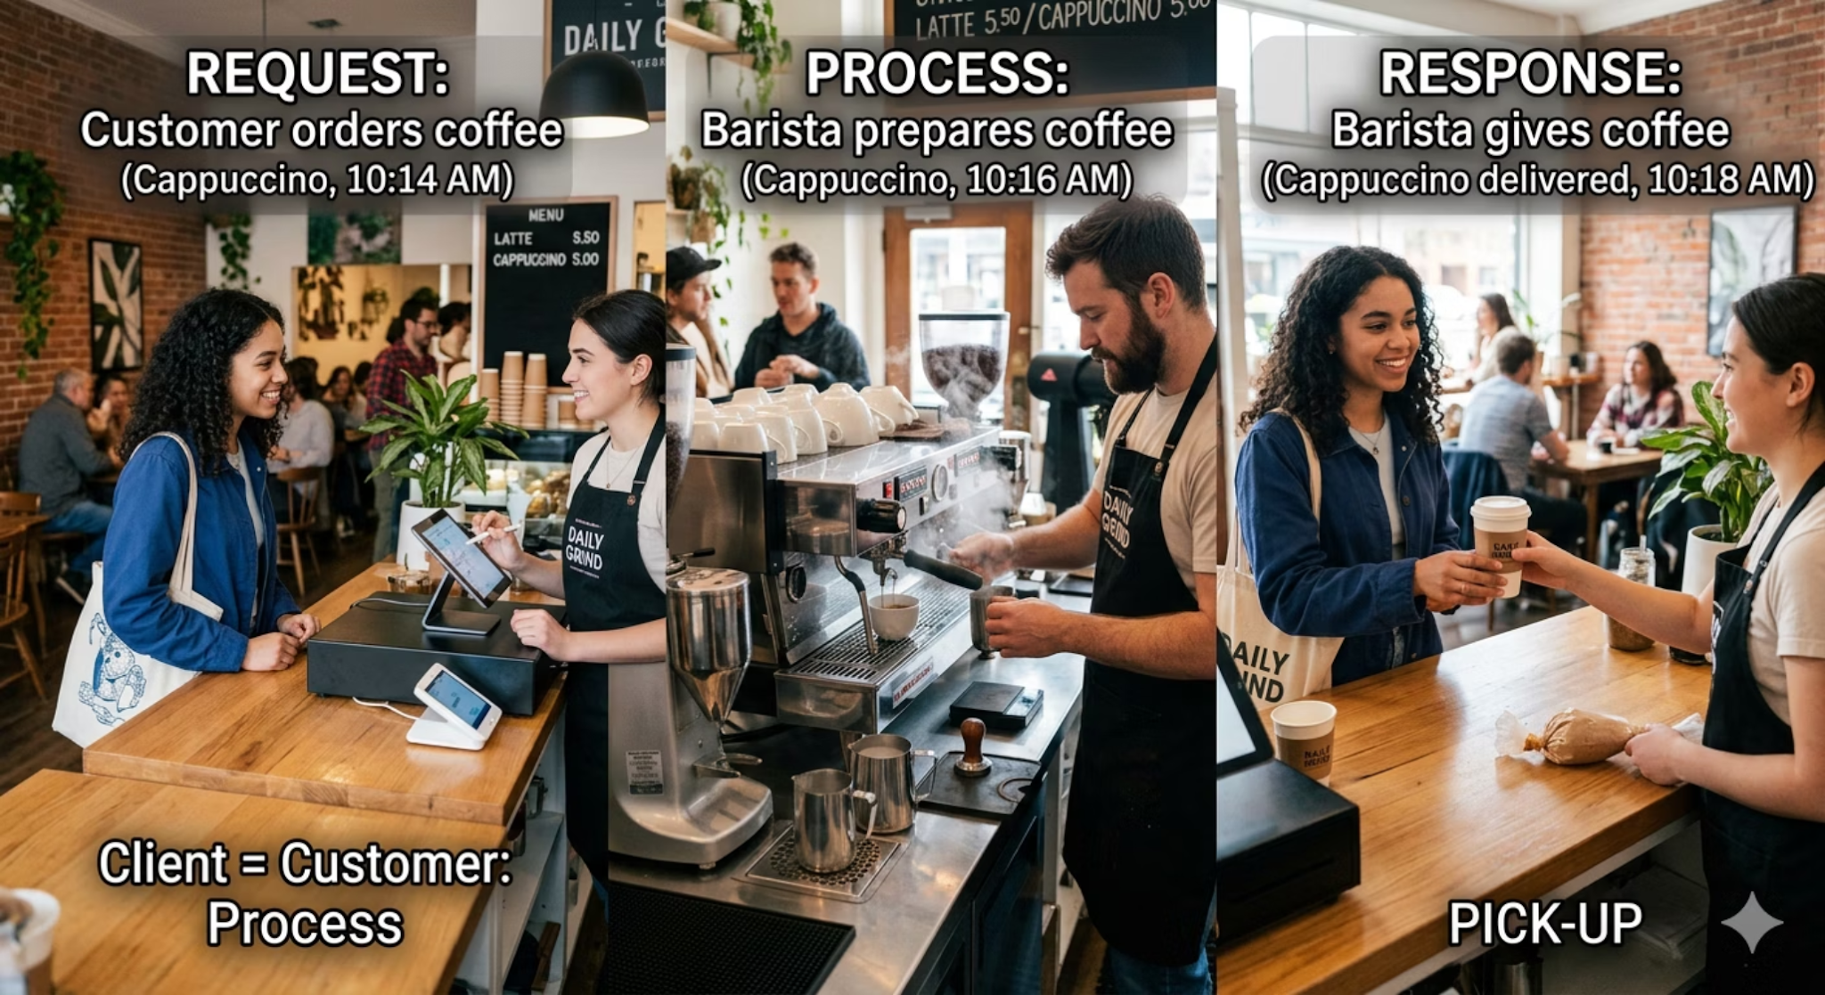
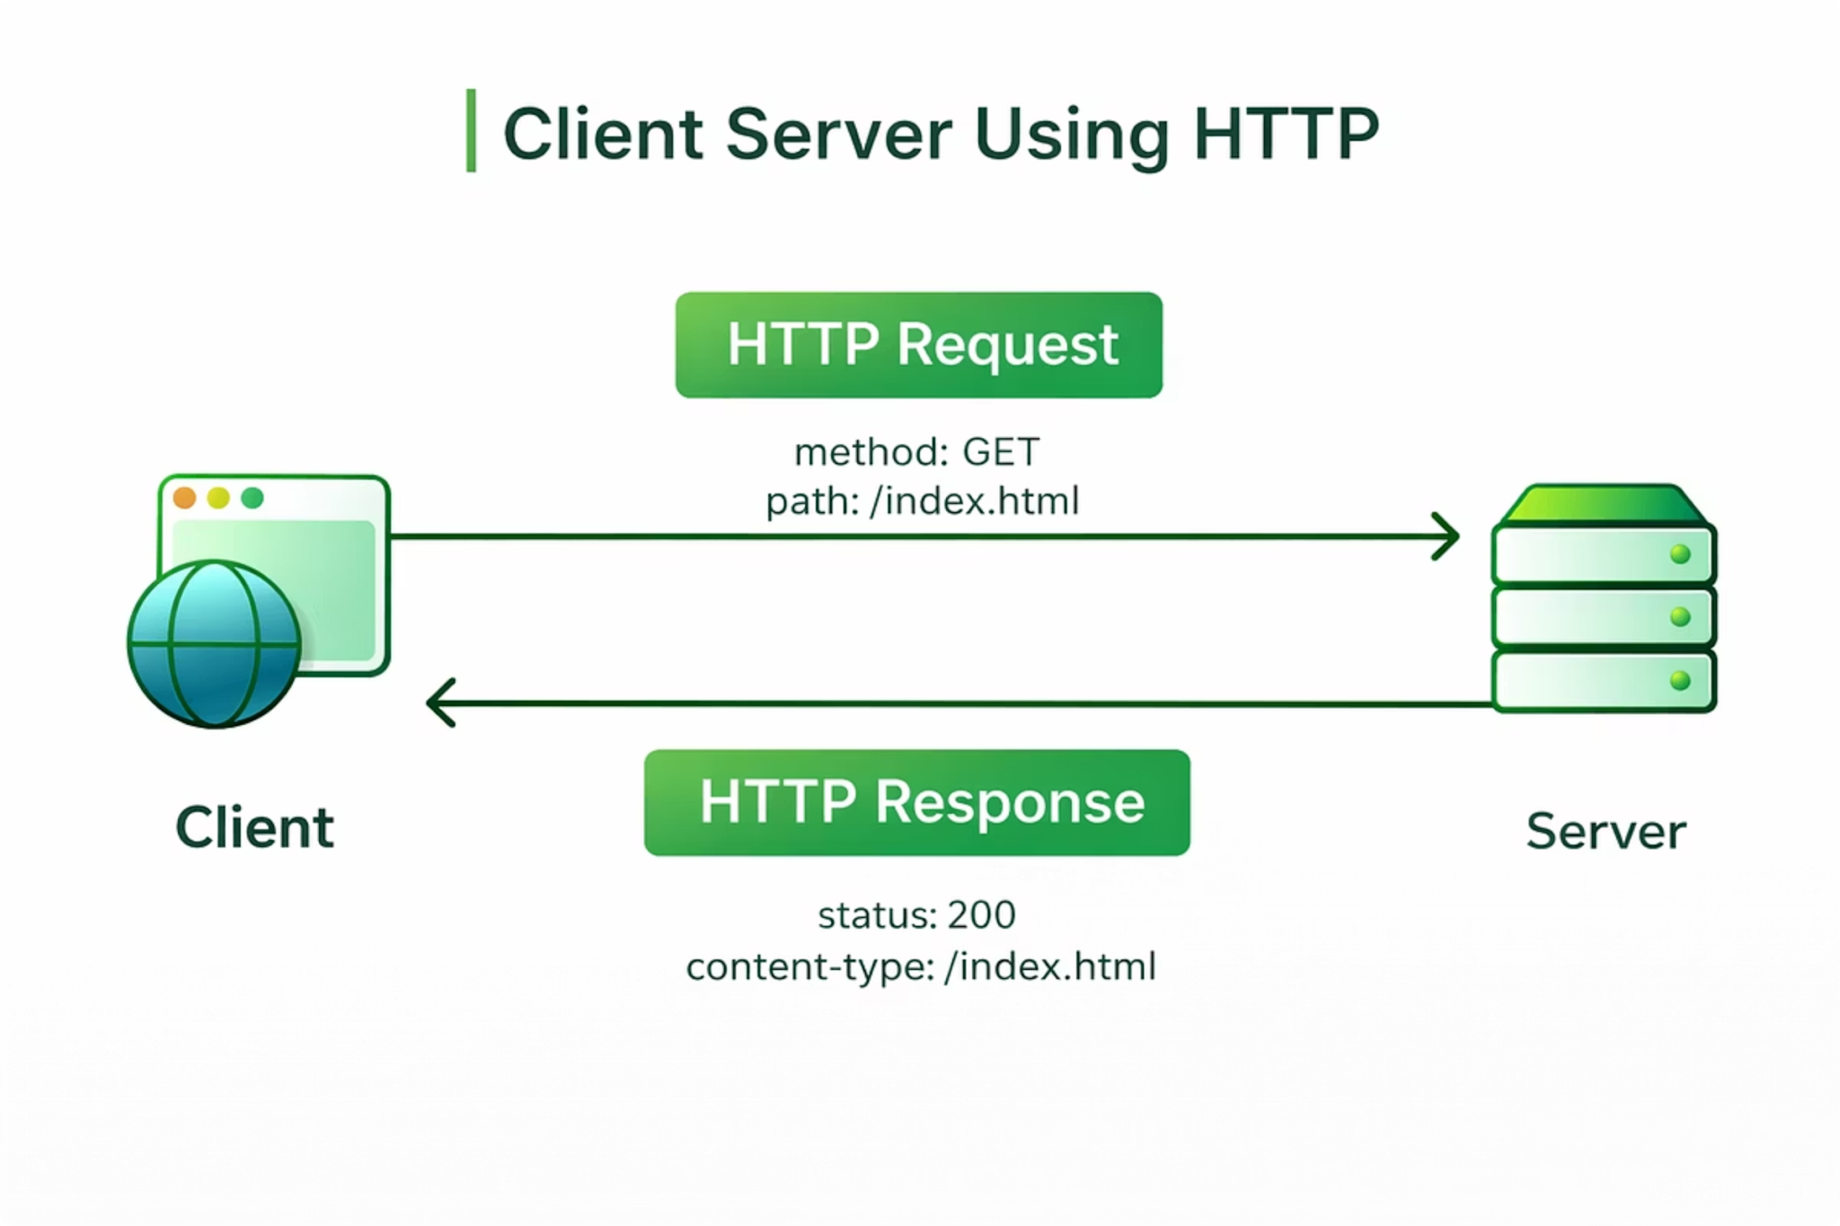
HTTP BASICS
What is HTTP?
HTTP = HyperText Transfer Protocol — the communication protocol used between client and server.
Example : Coffee Shop ☕
24

Slide 25
Quiz Time
Q1. When you search for a product on Amazon, how do results appear on your screen?
✅ Answer: The browser sends a request to the server, and the server sends back the product results.
Q2. Why do websites sometimes show a loading icon?
✅ Answer: Because the browser is waiting for the server to send the response.
Q3. What happens if the server does not respond?
✅ Answer: The website may show an error or fail to load.
25

Slide 26
HTTP Methods & Responses
HTTP Methods
Response Structure
GET
Retrieve data
Every response contains a Status Code, Headers, and Body.
POST
Send data
200
Success
PUT
Update data
404
Not Found
DELETE
Delete data
500
Server Error
Example: Login form → POST request
26

Slide 27

SCENARIO DISCUSSION
Scenario: Production Failure
Questions
Who detects it?
Who fixes it?
Developer's fault?
Infrastructure issue?
Situation
The website is down at 2 AM.
27

Slide 28
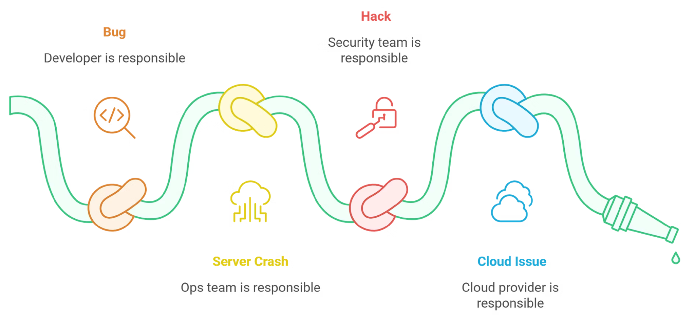
Who is Responsible?
Reality:
It’s a shared responsibility.
28

Slide 29
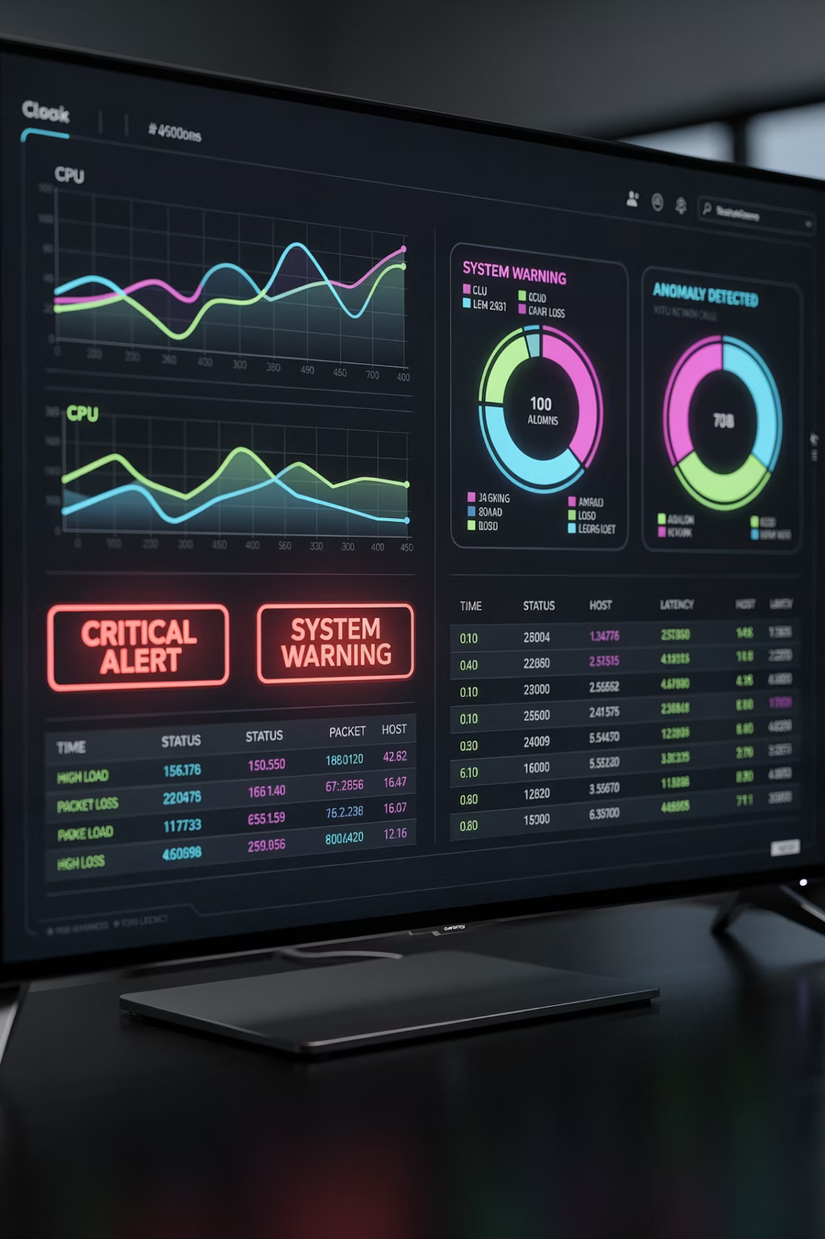
Modern Approach
Instead of blaming:
Monitor systems
Use alerts
Have backups
Incident management process
29

Slide 30

Discussion Questions
What happens if the database crashes?
Can frontend work without backend?
Why do we need DevOps?
What if the server is overloaded?
30

Slide 31
Day 1 Summary
1
2
3
4
Client vs Server
Web Applications
Frontend & Backend
Deployment & DevOps
Request-response model
Static vs dynamic
UI + server logic
Local to production
5
6
Architecture & HTTP
Production Responsibility
Protocols and flow
Shared ownership
31

Slide 32

Thank You
32

